Slide 1

ICT ,Summer Training

Slide 2

Project On Bug Tracking System
In The Guidance Of
Mr. Santosh Kumar
Presented By
Lov Niveriya
Diviyansh Kumar Tyagi
Bhoopesh Sharma
Anupam Patel

Slide 3
Bug Tracking System Modules
Manager
Admin
Developer
Tester

Slide 4
Module Description
Project Manager/Admin
Admin can add new user or can update the details of the existing user
Creates the project and assigns them to the employees for completing
Analyzing the project progress assigned to particular employee
Adding bug types, severity and status
Maintaining Project details, developer details and tester details.

Slide 5
Developer
View list of assigned projects
Responsible for bug status updation
Reset and edit his information like passwords

Slide 6
Tester
View list of assigned projects
Add bug details
View Bug status

Slide 7
Minimum Software Requirements
Operating system : Windows XP /2003 or Linux or Solaris
Programming Language : Java
Web Applications : JDBC
Database : Mysql
Client-side Scripting : JavaScript

Slide 8
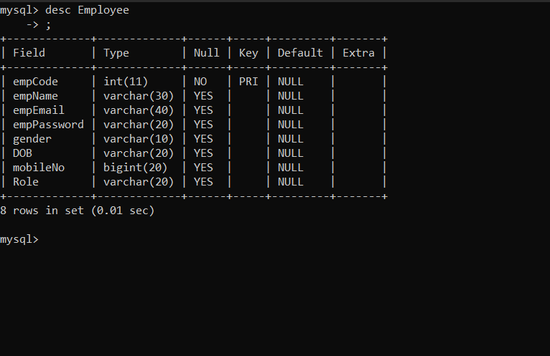
Database of Employee

Slide 9
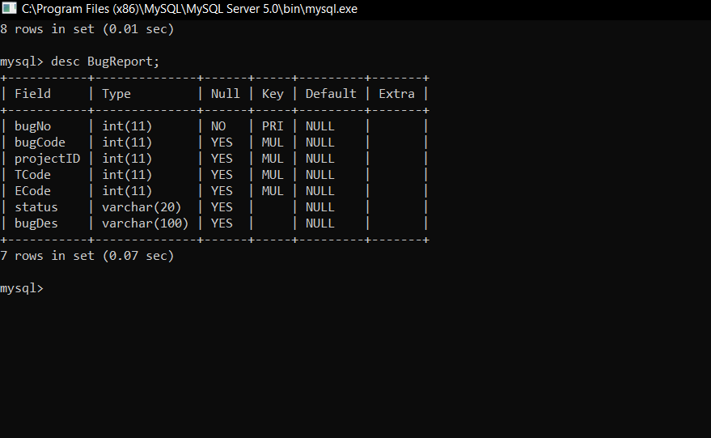
BugReport

Slide 10
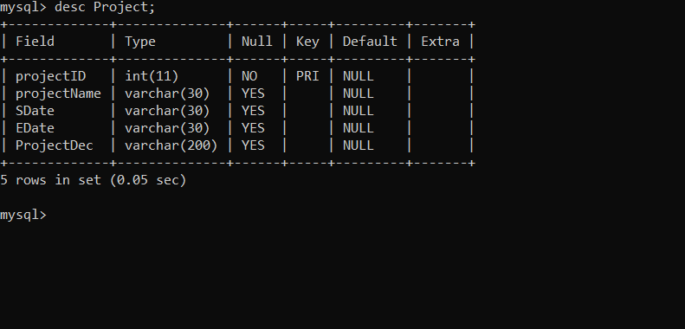
project

Slide 11
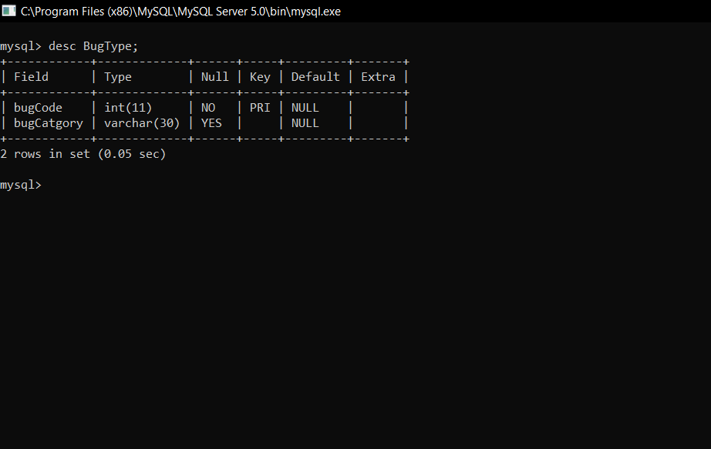
Bug Type

